Slide 1

STUDENT DETAILS
Name : pasupuleti.Jagadeeswari
Skills Build Email ID : pasupuletijagadeeswari2205@gmail.com
College Name : SRK INSTITUTE OF TECHNOLOGY
Internship Domain and Internship:
Cyber Security with Kali Linux

Slide 2

HIDING A TEXT INSIDE AN IMAGE USING STEGANOGRAPHY
An officer in danger requires a method to send a secret text message without alerting nearby criminals to his higher officials. Traditional communication methods are easily intercepted or monitored, so, he his necessitating a covert technique to embed and transmit critical information securely to his higher officials.

Slide 3
AGENDA
PROJECT OVERVIEW
SOFTWARE AND TOOLS SELECTION
WHO ARE THE END USERS OF THIS PROJECT?
YOUR SOLUTION AND ITS VALUE PROPOSITION
HOW DID YOU CUSTOMIZE THE PROJECT AND MAKE IT YOUR OWN
MODELLING
RESULTS
LINKS

Slide 4
PROJECT OVERVIEW
The practice of hiding information within other non-secret data, making the information discreet.
Purpose: To securely communicate sensitive information without revealing its existence.
Contrast with Cryptography: Unlike cryptography, which obscures the content , steganography conceals the very presence of the message.
Common Methods:
Least Significant Bit (LSB): Modifies the least significant bits of pixel values in images.
Audio Steganography: Hides data within audio files by altering sound waves.
Text Steganography: Uses whitespace, font styles, or specific patterns in text to hide information.
Applications:
Secure communication in military and intelligence.
Protecting personal privacy.
Conclusion: A valuable tool for secure communication and data protection when used responsibly

Slide 5
WHO ARE THE END USERS OF THIS PROJECT ?
Intelligence and Military Agencies : These agencies use steganography for secure communication, hiding sensitive information within innocuous-looking files to prevent detection by adversaries.
Privacy Advocates : Individuals concerned about privacy may use steganography to keep their communications hidden from surveillance and unauthorized access.
Cyber security Professionals : They use steganography for secure data transmission and also to understand and counteract steganographic techniques used by malicious actors.
Criminals and Hackers : Unfortunately, steganography can be used for nefarious purposes, such as hiding malware within seemingly harmless files, facilitating covert communication, or ex filtrating sensitive data.
Privacy Advocates : Individuals concerned about privacy may use steganography to keep their communications hidden from surveillance and unauthorized access.
Researchers and Educators : In the academic realm, researchers study steganography to advance the field and develop new methods, while educators teach it as part of computer science and cyber security curricula.
.

Slide 6
YOUR SOLUTION AND ITS VALUE PROPOSITION
Development of advanced, custom steganographic algorithms integrated with machine learning for enhanced adaptability and resistance to detection.
This ensures heightened security and future-proofing, making it increasingly difficult for unauthorized parties to detect and extract hidden messages.
Integration of steganographic techniques into embedded systems and IoT devices for secure data transmission.
Secures data transmission within IOT networks, safeguarding against unauthorized access and data breaches. This is particularly crucial as the number of interconnected devices continues to grow, making IOT networks more vulnerable to security threats.
Ensuring that steganographic solutions help organizations comply with data protection regulations and standards.

Slide 7
HOW DID YOU CUSTOMIZE THE PROJECT AND MAKE IT YOUR OWN
Automated Stegan alysis : Sophisticated, automated stegan alysis tools were created to detect and analyze hidden information within media files, providing detailed reports and alerts tailored to different user needs
Automated Stegan alysis Tools : Sophisticated, automated stegan alysis tools were created to detect and analyze hidden information within media files, providing detailed reports and alerts tailored to different user needs.
User-Friendly Software : The software developed features an intuitive interface that simplifies the process of embedding and extracting hidden messages, with customizable settings to meet specific user requirements.
Unique Algorithm Development :I developed custom steganographic algorithms tailored to specific needs, incorporating robust encryption and compression methods to enhance security and efficiency.
Integration of Machine Learning : By integrating machine learning, the steganographic methods are adaptive and evolve to counter new detection techniques, ensuring long-term security.

Slide 8
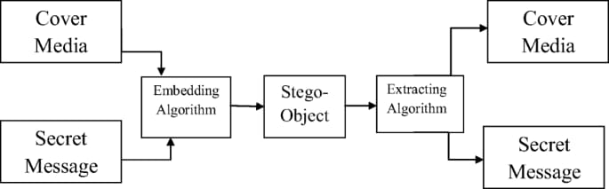
MODELLING
Input includes text, image, audio, or video that needs to be hidden. This is the data to be securely embedded within the cover medium.
This step involves embedding the secret message into the cover medium, which results in the production of the stego medium containing the hidden message.
The cover medium can be an image, audio, or video file used as the carrier. It appears as an ordinary file while concealing the secret message.
The stego medium is the modified cover medium with the embedded secret message. It ensures that the hidden message is not easily detectable.
the steganographic extraction algorithm is used to retrieve the hidden secret message from the stego medium.
The extracted secret message is retrieved in its original form, whether it's text, image, audio, or video.

Slide 9
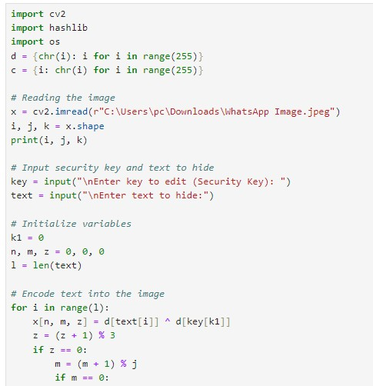
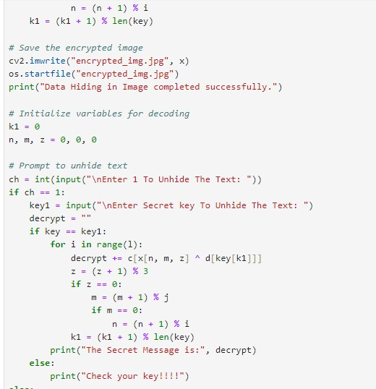
RESULTS

Slide 10
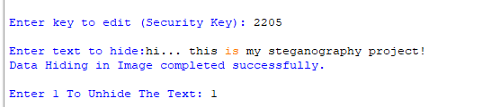
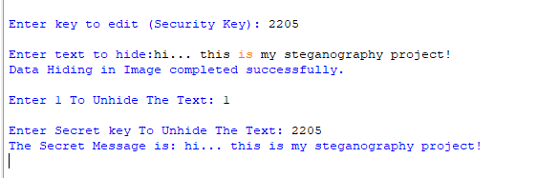
Output :
Input :
Encrypted message :

Slide 11


Original image
Encrypted image
Above image is normal image.
We can choose the image on which we want to do the encryption
We can see there is no difference in both the normal and encrypted images

Slide 12
LINKS
https://github.com/jagadeeswari-pasupuleti/steganography

Slide 13
Thank You

